Slide 1
Direct User Registration
Confirm Number (Button)
Enter Verification Code

Slide 2
Step 2: Choose Class.
Class 8
Class 7
Class 6
Class 5

Slide 3
Student Dashboard. Class 8. Name: Alex Ngeno User ID: 001001.
Successful Registration after choosing class (Dashboard)
Balance 0.00
Deposit.
Use PayBill no. 909090. Account Number: 001001.
Maths | Start test
English | Start test
Kiswahili | Start test
Science | Start test
Social Studies, CRE, IRE | Start Test
Invited tests
English
Kiswahili
Results
Completed | Pending
Maths Paper 1 | Science paper 2
Maths paper 2 | English Paper 3
The button becomes active for completed only

Slide 4
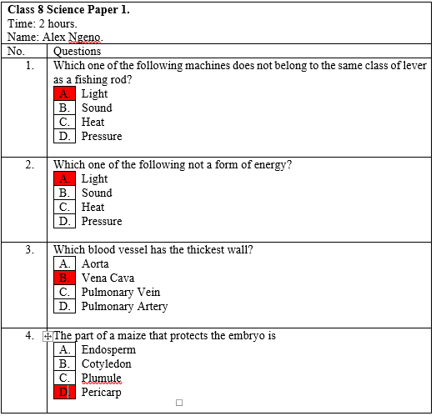
Student Exam session Appearance. (Start Test or Invited)
Tick the right answer
Complete Test. If 50/50 The button should appear
Questions Answered: 4/50 or 4/10. Whatever the set Number.
Previous
Next

Slide 5
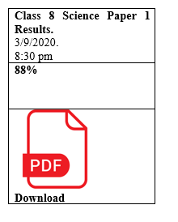
Class 8 Science Paper 1 Results (Either self or administered)

Slide 6
Results: Click the subject to download the scripts for Revision.
 | PP1 | PP2 | PPP3 | PP4 | PP5 | PP6 | PP7 | PP8 | AVERAGE
Maths | 70 | 80 | 90 | 60 | 70 | 60 | 80 | 90 | 75
English | 70 |  |  |  |  |  |  |  | 70
Kiswahili
Science
Social studies, CRE, IRE
TOTAL |  |  |  |  |  |  |  |  | 350

Slide 7
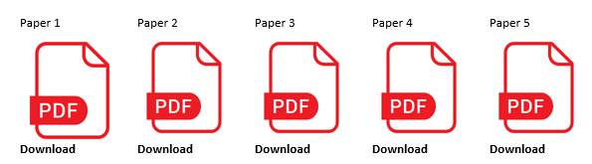
Results For Science when subject button is clicked.

Slide 8
Social Studies/ CRE/ IRE (Special Case) Weight of the correct answer is 1.11. Rounded off to the nearest decimal. If 99.99 then score becomes 100%. 99.44 it becomes 99%.
Proceed with CRE. (1-30)
Question 1-60. S/S Complete.
Proceed with IRE. (1-30)

Slide 9
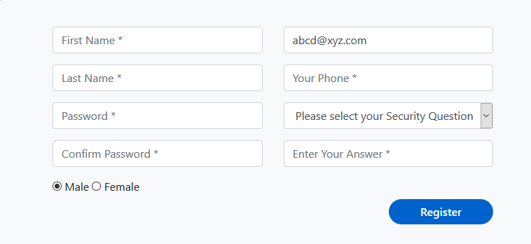
Agent Registration

Slide 10
Account Type: Jitihada Free
Name: Alex Ngeno User ID: 0700629339
Credits: Ksh 500
Redeem.
Add New User
Set Test
My Students
My Tests
Deposit
Upgrade Now And Earn Up To Ksh 5,000 Daily.

Slide 11
Upgrade
 | Jitihada Plus | Jitihada Prime | Jitihada Expert | Jitihada Professional
Benefits | Up to 100 | Up to 200 | Up to 500 | Above 500
Number of Tests | Unlimited | Unlimited | Unlimited | Unlimited
Commission
Schedule an Exam
Badges
Upload Questions
1 Month upgrade | Buy Ksh 200 | Buy Ksh 500 | Buy Ksh 750 | Buy Ksh 1000
3 Months Upgrade | Buy Ksh 400 | Buy Ksh 1000 | Buy Ksh 1500 | Buy Ksh 2000
6 Moths Upgrade | Buy Ksh 900 | Buy Ksh 2500 | Buy Ksh 4000 | Buy Ksh 5000
12 Months Upgrade | Buy Ksh 1500 | Buy Ksh 5000 | Buy Ksh 7500 | Buy Ksh 9000

Slide 12

Jitihada Plus
Up to 100
Unlimited
Buy Ksh 200
Buy Ksh 400
Buy Ksh 900
Buy Ksh 1500
Successful / Not enough balance please deposit.
Use PayBill no. 909090. Account Number: you phone No.
Confirm Package

Slide 13
Add New User (Only Agent Can Do This)
Student Name
User ID. (Agent given Admission number)
Password
Confirm Password
(At least 8 characters)
Next

Slide 14
Add New User Choose Class.
Class 8
Class 7
Class 6
Class 5

Slide 15
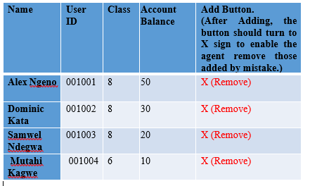
Set Tests Select One.
Select Class Select Subject Invite (Only Your Students)
Class
8
7
6
5
Math
English
Kiswahili
Science
Social Studies
CRE
IRE.

Slide 16
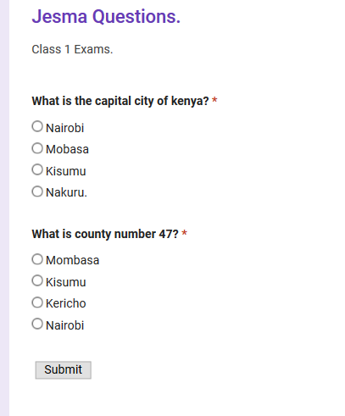
Choose Questions Set Time. 90mins + - (Buttons)
Social Studies Questions Auto-Generated From The Site.
Review and Complete

Slide 17
Review and Complete. (should show all the questions selected plus a button for removing ones selected by mistake)
Which one of the following machines does not belong to the same class of lever as a fishing rod? A. Spade B. Stapler C. Coal tong D. Nut cracker | X (Remove)
Select More Questions
Set Exam.

Slide 18
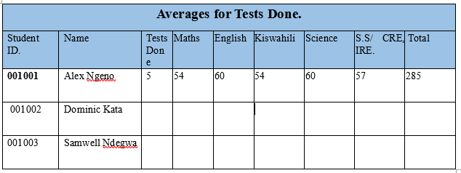
Agent: My students
Student ID. | Name | Tests Done | Account status/Balance
001001 | Alex Ngeno | 5 | 50
001002 | Dominic Kata | 10 | 100
001003 | Samwell Ndegwa | 15 | 30

Slide 19
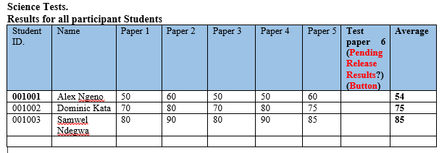
My Tests (Set By the Agent)

